Slide 1



Phillippa Biggs
Coordinator, Broadband Commission
for Digital Development
Palais des Nations, UN,
21 September 2015

Slide 2
Broadband Commission for Digital Development
State of Broadband 2015 – mixed messages
Every year, the Broadband Commission for Digital Development takes the pulse of global broadband industry.
This year’s report finds mixed messages – while pockets of growth continue in mobile broadband and Facebook users, overall growth in Internet usage is slowing, as networks roll out beyond densely populated urban areas.
By end 2015, some 3.2 billion people will be online, over 43.4% of the total world population and up from 2.7 billion a year earlier, but some 4 billion people remain offline.
Challenges for connecting the next billion people include universal access and the language barrier.

Slide 3
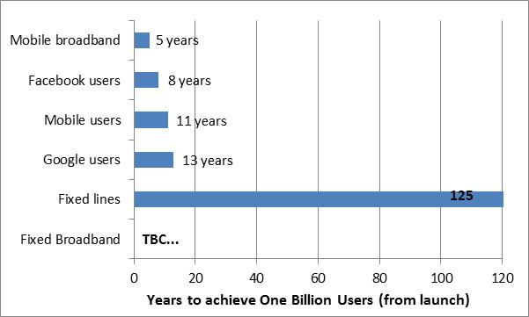
Broadband Commission for Digital Development
Mobile broadband fastest-growing
technology in history
Source: ITU.
Notes:
We’ve seen very rapid growth – here is the time taken to reach 1 billion users (from launch) for some different (amalgams of) technologies and the Internet heavyweights, Facebook (now at 1.44 bn users, March 2015) and Google (estimated to be at 2.2 bn users across all its different services).

Slide 4
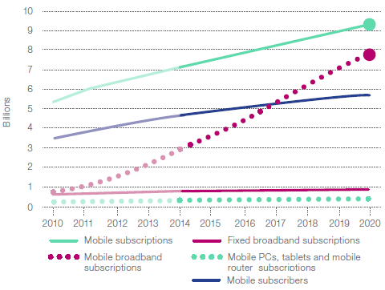
Broadband Commission for Digital Development
Has the digital divide been bridged?
Subscriptions v. Subscribers
Source: Ericsson.
Notes:
Some observers are commenting that, with mobile subscriptions surpassing 7 billion this year and predicted to reach 7.1 billion by the end of this year, nearly equivalent to the global population, mobile telephony has bridged the digital divide. However, in mature markets, quite a number of people have multiple subscriptions to take advantage of different pricing packages, the work/life distinction etc. So in fact, the actual number of unique mobile subscribers is estimated at between 3.7-5 billion people this year i.e. between 50-75% of the world’s population owning a mobile phone (access will be a little higher).
Then if we take into account the speeds, we can see that the digital divide will still be with us for some time yet.

Slide 5
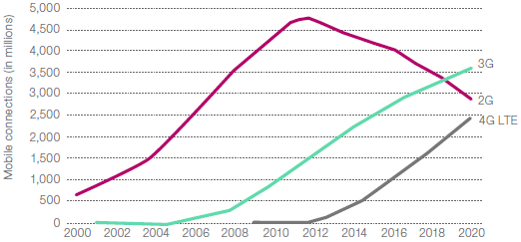
Broadband Commission for Digital Development
4G networks & subscriptions taking off – 2014 a transition point
Source: Telegeography (left); GSMAi (right).
Notes:
The evidence suggests that 2014 may prove something of a transition point, as the year when growth in 3G started to slow, as growth in 4G started to accelerate rapidly. The number of countries with 3G and 4G coverage is growing fast - By the end of 2014, Telegeography reports that 2G networks had been
deployed in 200 countries, active 3G networks were commercially available in 192 countries and 4G networks had been deployed in 102 countries. In July 2015, the Global mobile Suppliers Association (GSA) reported that 422 operators had launched commercial LTE systems in 143 countries, with 460 commercially launched LTE networks by end 2015.

Slide 6
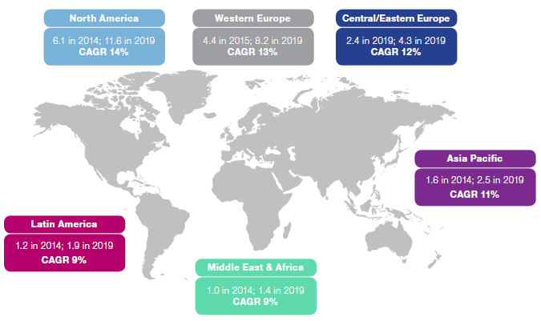
Broadband Commission for Digital Development
New divide emerging in connected devices per capita for different regions
Source: Cisco VNI.
Notes:
In the meantime, it is also worth remembering that the digital divide continues to take on new forms – here we see divides in the number of ‘connected devices’ per capita. This is very loosely defined, so it includes mobiles, dongles, USB cards, and may include connected cars or sensors where these are wired up to connect via the Internet. For some consultancies, it also includes wearables (such as glasses etc), but it does not include RFID chips. But however it is defined, there are large and growing discrepancies between levels of connected devices per capita for different regions.

Slide 7
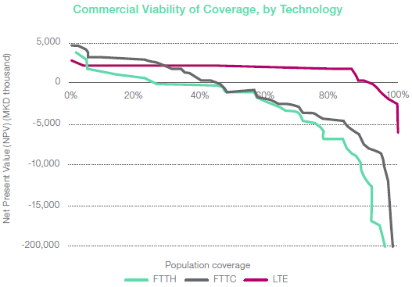
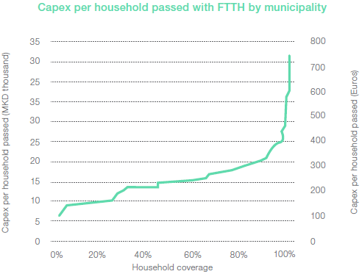
Broadband Commission for Digital Development
Supply side challenge – extending network access beyond urban areas
Source: Analysys Mason.
Notes:
Major supply-side challenges exist in expanding the Internet and web to accommodate the next four billion people – notably, extending present-day networks outside urban areas into rural or remote areas, and upgrading networks to cope with the growth in traffic. The challenge of universal access stems from steep increases in marginal costs of network deployments for less densely populated or more remote areas, jeopardizing the viability of service provision on a commercial for-profit basis.
As one example of just how steeply costs can rise, Analysys Mason (2015) recently calculated the commercial viability of deploying different technologies in different municipalities in TFYR Macedonia by calculating the Net Present Value (NPV) of a roll-out over the period 2015–2023. Their estimates of viable coverage vary, depending on the broadband technology, but range from 44% coverage for FTTH (covering mainly urban/suburban Areas) to 51% for DOCSIS3.0 and 94% for LTE i.e. covering most of the territory. (These coverage levels vary, depending on the country and its geography, population distribution and terrain). Even in Europe, many countries still have a way to go to achieve these levels of coverage, with only four countries globally over 25% FTTH+FTTB and only six countries over 20% FTTH+FTTB coverage

Slide 8
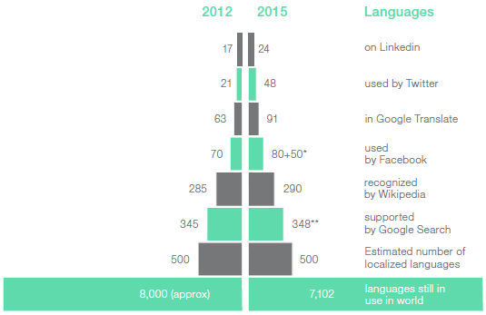
Broadband Commission for Digital Development
Demand side challenge –
Lack of languages online is a barrier
Online language profile fails to reflect speaker base;
Growth in languages online is not matching overall growth;
Online services are multinational, but are they multilingual?
Source: ITU, based on various sources.
Notes:
Among the major demand challenges involved in connecting the next, and the last, billion people is the lack of languages online. Recent research by UNESCO suggests that only a fraction of the world’s spoken languages (around 5%) of languages have made it online. Online language profile fails to reflect the real-world speaker base; Growth in languages online is not matching overall growth. This chart shows that online services may be multinational, but are they multilingual?

Slide 9
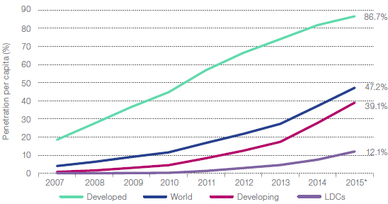
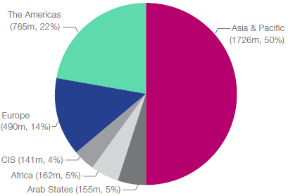
Strong growth in Mobile Broadband
→ Strong growth in subscriptions and penetration
→ Asia-Pacific success story:
The rapid expansion of Asia-Pacific squeezing other regions’ market shares – despite increases in subscribers,
Europe 16% ->14% ;
Americas 24% ->22%.
Source: ITU.

Slide 10
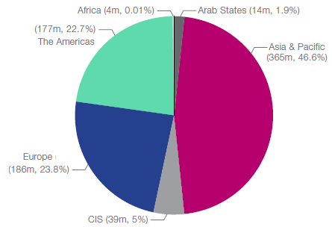
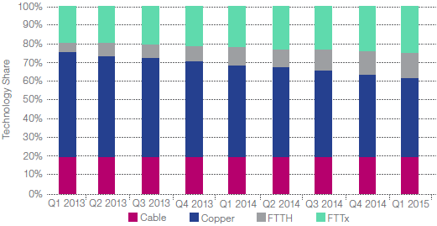
Moderate growth in Fixed Broadband
→ 794 million by end 2015.
Asia-Pacific increased its share of subscribers from
45% to 46%.
→ Strong growth in subscriptions and penetration
Source: ITU (above);
Point Topic (bottom).

Slide 11
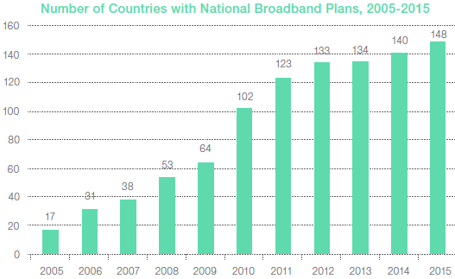
Broadband Commission for Digital Development
Target 1: National Broadband Plans
Vitally important that countries should develop a Broadband Plan
148 countries now have a Plan in place, with 6 NBPs underway, but succession strategy for Plans expiring in 2015 unclear.
Source: Broadband Commission for Digital Development.

Slide 12
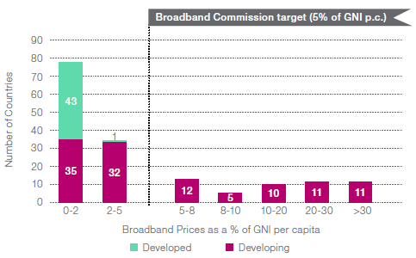
Broadband Commission for Digital Development
Target 2: Affordability
By 2014, 111 countries have met the Broadband Commission target of 5% per capita, up from 108 countries in 2013.
Source:
ITU.
Notes:
By 2014, 111 countries have met the Broadband Commission target of 5% per capita, up from 108 countries in 2013.

Slide 13
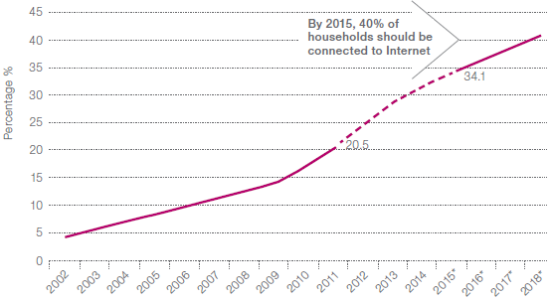
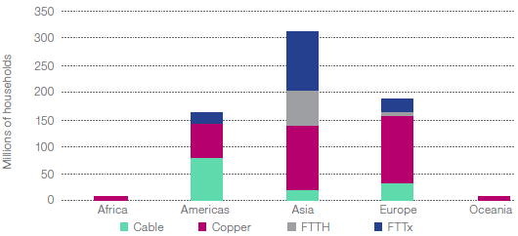
Broadband Commission for Digital Development
Target 3: Getting households online
By 2015, 40% of households in developing countries should have Internet access.
Actual: 46.4% world; 34.1% developing and 7% in LDCs
Source: ITU (left); Point Topic (right).
Notes:
In 2011, the Broadband Commission established its target for household Internet access of 40% in developing countries by 2015. In fact, we can see that the rate at which households are becoming connected has slowed significantly, and that this target is very unlikely to be achieved before 2018 at the earliest.
In terms of absolute numbers of homes connected via broadband, Asia accounts for the largest absolute number of broadband-connected homes, nearly as many as Europe and the Americas put together. For homes connected via fixed broadband, copper still accounts for most of the connected homes in Europe, half of Asian connections and a third of all broadband connections in the Americas. Cable accounts for nearly half the market in the Americas. Africa and Oceania have fairly few broadband-connected households in absolute numbers.

Slide 14
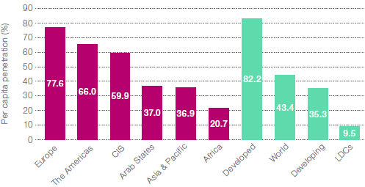
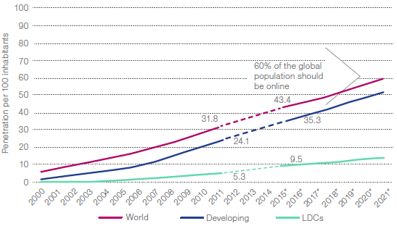
Broadband Commission for Digital Development
Target 4: Getting people online
By 2015, Internet user penetration should reach 60% worldwide, 50% in developing countries and 15% in LDCs:
Actual: 43.4% world; 35.3% developing and 9.5% in LDCs
Source: ITU.
Notes:
The fourth target covers the percentage of the population that uses the Internet. A large number of countries measure and monitor population coverage targets, but by no means all.
By the end of 2015, ITU projects that 3.2 billion people or some 43.4% of the global population will be online. This is far behind the target, which is only likely to be achieved by 2020. Over half the world’s population – or more than 4 billion people - are still offline.

Slide 15
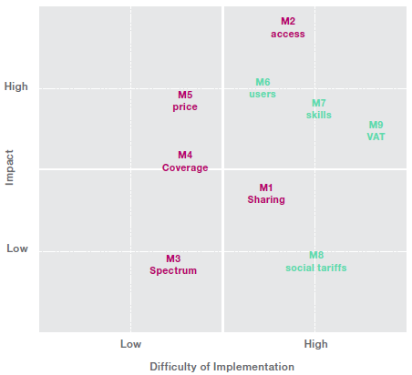
Broadband Commission for Digital Development
Policy Measures for Broadband
Source: Broadband Commission, based on Analysys Mason.
Notes:
Of course, policy is not just about dreaming big dreams – many people can do this, but it is also vital to take into account the ease (or difficulty) of implementation and the likely impact. These are difficult factors to predict, as it often depends on the individual country circumstances. But this slide shows an assessment by Analysys Mason for a representative emerging economy for different policy measures – the green are demand side measures, and purple supply side measures.

Slide 16
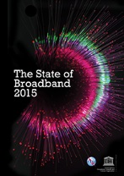
Thank you for your attention
www.broadbandcommission.org
facebook.com/broadbandcommission
Phillippa.biggs@itu.int
Notes:
Thank you very much, and I am very happy to answer any questions you may have.

